Slide 1




Slide 2

Data Link Layer (Part-I)

Slide 3
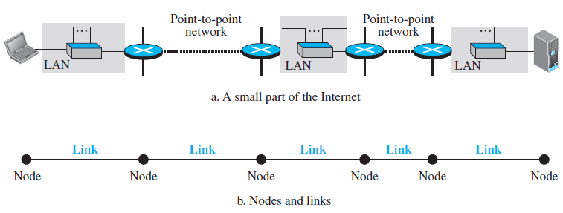
Introduction
The first node is the source host
The last node is the destination host
The other four nodes are four routers.
The first, the third, and the fifth links represent the three LANs;
The second and the fourth links represent the two WANs.

Slide 4
Introduction
To better understand the functionality and the services, the data-link layer is divided into two sublayers:
data link control (DLC) and
media access control (MAC)
The data link control sublayer deals with all issues common to both point-to-point and broadcast links.
The media access control sublayer deals only with issues specific to broadcast links
Notes:
f

Slide 5
Introduction
The data link layer is responsible for hop-to-hop (node-to-node) delivery.
Although two nodes are physically connected by a transmission medium such as cable or air, we need to remember that the data-link layer controls how the medium is used.
The duties of the data link layer are
Framing
Physical Addressing
Flow Control
Error control
Access control

Slide 6
Framing
The data link layer divides the stream of bits received from the network layer into manageable data units called frames.
Framing in the DLL separates a message from one source to a destination by adding a sender address and a destination address.
Although the whole message could be packed in one frame, that is not normally done.
One reason is that a frame can be very large, making flow and error control very inefficient.

Slide 7

Frame Size
Frames can be of fixed or variable size
In fixed-size framing, there is no need for defining the boundaries of the frames; the size itself can be used as a delimiter. An example of this type of framing is the ATM WAN, which uses frames of fixed size called cells.
The main discussion concerns variable-size framing, prevalent in local-area networks.
In variable-size framing, we need a way to define the end of one frame and the beginning of the next.
Character-Oriented Framing

Slide 8
In character-oriented (or byte-oriented) framing, data to be carried are 8-bit characters from a coding system such as ASCII .
The header, which normally carries the source and destination addresses and other control information, and the trailer, which carries error detection redundant bits, are also multiples of 8 bits.
To separate one frame from the next, an 8-bit (1-byte) flag is added at the beginning and the end of a frame.
The flag, composed of protocol-dependent special characters, signals the start or end of a frame.

Slide 9
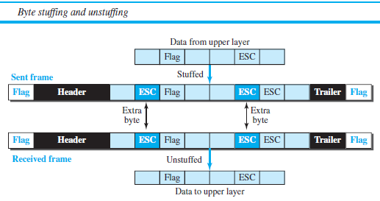

Slide 10

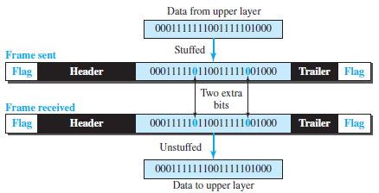
Bit-Oriented Framing
Bit stuffing is the process of adding one extra 0 whenever five consecutive 1s follow a 0 in the data, so that the receiver does not mistake the pattern 0111110 for a flag.

Slide 12
Physical Addressing
If the frames are to be distributed to different systems on the network the data link layer adds a header to the frame to define the receiver or sender of the frame.
If the frame is intended for a system located outside the senders’ network, then the receiver address is the address of the connecting device that connects the network to the next one.

Slide 13
The physical address, also known as the link address, is the address of a node as defined by its LAN or WAN.

Slide 14
What is the size of link-layer addresses?
It depends on the protocol used by the link.
Although we have only one IP protocol for the whole Internet, we may be using different data-link protocols in different links.
This means that we can define the size of the address when we discuss different link-layer protocols…

Slide 15

Three Types of addresses
Some link-layer protocols define three types of addresses
Unicast Address
Unicasting means one-to-one communication.
Each host or each interface of a router is assigned a unicast address.
An interface is a connection of a router to a link.
The unicast link-layer addresses in the most common LAN, Ethernet, are 48 bits (six bytes) that are presented as 12 hexadecimal digits separated by colons
$$A3:34:45:11:92:F1$$

Slide 16

Multicast Address
Multicasting means one-to-many communication.
The multicast link-layer addresses in the most common LAN, Ethernet, are 48 bits (6 bytes) that are presented as 12 hexadecimal digits separated by colons.
The second digit, however, needs to be an even number in hexadecimal.
$$A2:34:45:11:92:F1$$
Broadcast Address
Broadcasting means one-to-all communication.
A frame with a destination broadcast address is sent to all entities in the link.
The broadcast link-layer addresses in the most common LAN, Ethernet, are 48 bits, all 1s, that are presented as 12 hexadecimal digits separated by colons.
$$FF:FF:FF:FF:FF:FF$$

Slide 17
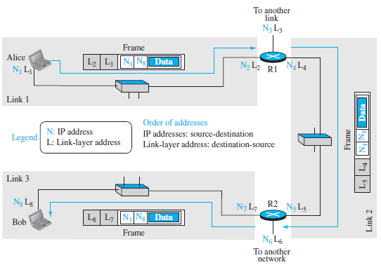
IP addresses and link-layer addresses in a small internet

Slide 18
Address Resolution Protocol (ARP)
The ARP protocol is one of the auxiliary protocols defined in the network layer
It belongs to the network layer, but we discuss it here because it maps an IP address to a logical-link address.
ARP accepts an IP address from the IP protocol, maps the address to the corresponding link-layer address and passes it to the data-link layer.

Slide 19
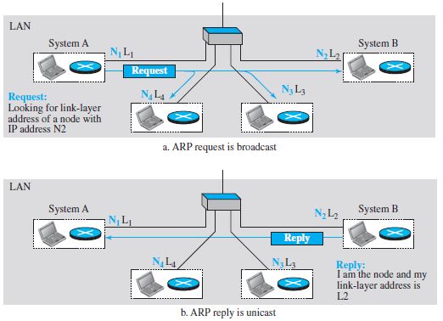
ARP Operation

Slide 20
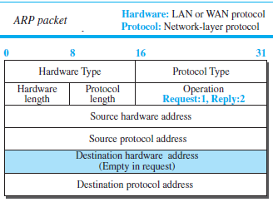

Slide 21
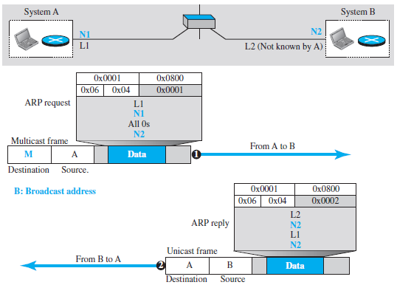

Slide 22
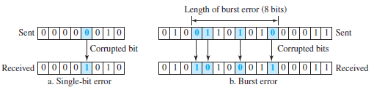
Error Detection and Correction
Whenever bits flow from one point to another, they are subject to unpredictable changes because of interference.
single-bit error : only 1 bit of a given data unit (such as a byte,
character, or packet) is changed from 1 to 0 or from 0 to 1.
Burst error : 2 or more bits in the data unit have changed from 1 to 0 or from 0 to 1.

Slide 23
The central concept in detecting or correcting errors is redundancy.
Redundancy is achieved through various coding schemes (Block coding, Convolutional coding)
In Error detection, The answer is a simple yes or no, for any error has occurred or not.
In error correction, the exact number of bits that are corrupted
and, more importantly, their location in the message.
The number of errors and the size of the message are important factors.
If we need to correct a single error in an 8-bit data unit, we need to consider eight possible error locations.

Slide 24

Block Coding
In block coding, we divide our message into blocks, each of k bits, called datawords.
We add r redundant bits to each block to make the length n = k + r.
The resulting n-bit blocks are called codewords.
With k bits, we can create a combination of $2^{k}$ datawords; with n bits, we can create a combination of $2^{n}$ codewords.
Since $n > k$, the number of possible codewords is larger than the number of possible datawords.
The block coding process is one-to-one; the same dataword is always encoded as the same codeword.
This means that we have $2^{n}−2^{k}$ codewords that are not used. We call these codewords invalid or illegal.
The trick in error detection is the existence of these invalid codes. If the receiver receives an invalid codeword, this indicates that the data was corrupted during transmission.

Slide 25
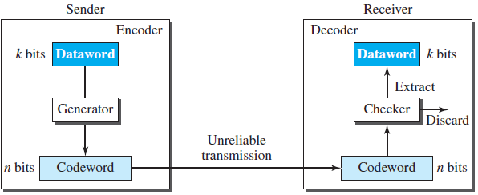
If the following two conditions are met, the receiver can detect a change in the original codeword.
The receiver has (or can find) a list of valid codewords.
The original codeword has changed to an invalid one.
Process of error detection in block coding
*However, if the codeword is corrupted during transmission
but the received word still matches a valid codeword, the error remains
undetected.

Slide 26



Example (k=2, n=3)
The Hamming distance, $d(x, y)$ between two words $x$ and $y$ is the number of differences between corresponding bits.
if the codeword $x=00000$ is sent and $y=01101$ is received, then $d(x,y)=d(00000, 01101)=3.$
Hamming distance between two pairs of words can be found by performing XOR operation.
The Hamming distance $d(000, 011)$ is 2 because ($000 ⊕ 011$) is $011$ (two 1s).
The Hamming distance $d(10101, 11110)$ is 3 because ($10101 ⊕ 11110$) is 01011 (three 1s).

Slide 27
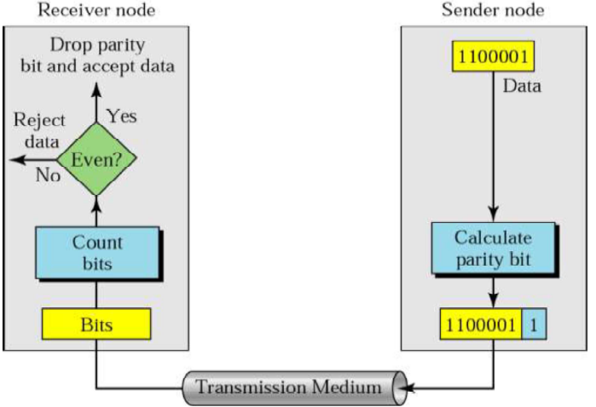
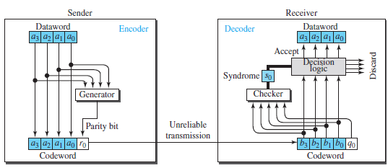
Parity Check
Example
XOR
XOR

Slide 28
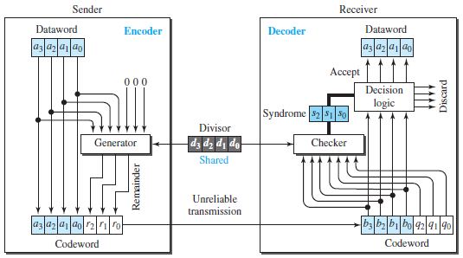
Cyclic Redundancy Check

Slide 29
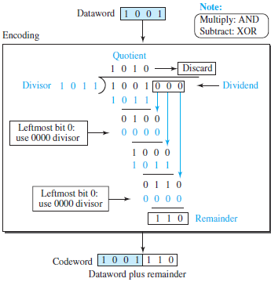
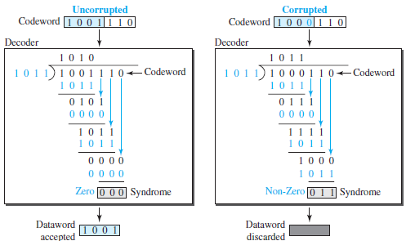
CRC example

Slide 30
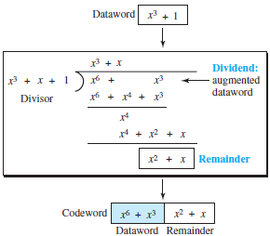
CRC with polynomials
The divisor in a cyclic code is normally called the generator polynomial or simply the generator.
Notation:
Dataword: d(x)
Codeword: c(x)
Generator: g(x)
Syndrome: s(x)
Error: e(x)

Slide 31
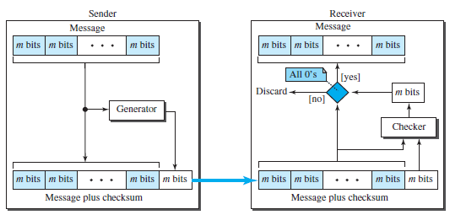
Checksum

Slide 32

Suppose the message is a list $(7, 11, 12, 0, 6)$.
we send $(7, 11, 12, 0, 6, 36)$, where 36 is the sum of the original numbers.
The receiver adds the five numbers and compares the result with the sum. If the two are the same, the receiver assumes no error, accepts the five numbers, and discards the sum. Otherwise, there is an error somewhere and the message is not accepted.
Drawback: The sum may have more bits compared to the message blocks. In such case wrapping is used.
the decimal number 36 in binary is ${\left(100100\right)}_{2}$. To change it to a 4-bit number we add the extra leftmost bits to the right four bits.
$${\left(10\right)}_{2}+ {\left(0100\right)}_{2}= {\left(0110\right)}_{2}= {\left(6\right)}_{10}$$

Slide 33
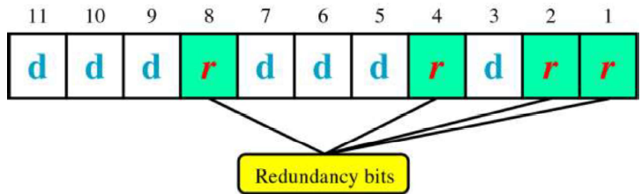


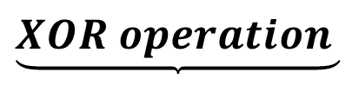
Error Correcting Code (Hamming Code)
If there are m-bits (message) to be transmitted, the required number of redundancy bits (r) should satisfy
$2^{r}≥ m+r+1$
If the total number of bits in a transmittable unit is $m+r$, then $r$ must be able to indicate at least $m+r+1$ different states.
The positions of redundancy bits in Hamming code:
$$\underset{}{\underbrace{XOR operation }}$$

Slide 34
Error Control
Reliability is added to the physical layer by data link layer to detect and retransmit loss or damaged frames and,
Also to prevent duplication of frames which is achieved through a trailer added to the end of the frame.
Error control in the data link layer is based on ARQ (automatic repeat request), which is the retransmission of data.
The term error control refers to methods of error detection and retransmission.
Anytime an error is detected in an exchange, specified frames are retransmitted. This process is called ARQ.

Slide 35
Flow and Error Control
There are three Error Control mechanisms
STOP-AND WAIT ARQ.
GO-BACK-N ARQ.
SELECTIVE-REPEAT ARQ

Slide 36
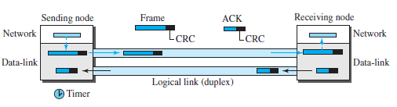
Stop-and-Wait Protocol
The Stop-and-Wait protocol uses both flow and error control.
The Stop-and-Wait protocol uses both flow and error control.

Slide 37
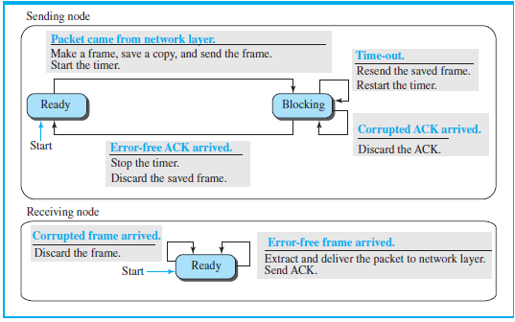
Finite state machine (FSM) for the Stop-and-Wait protocol

Slide 38
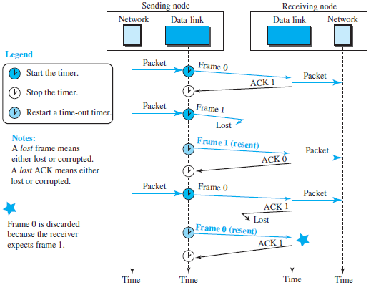
Flow diagram of Stop-and-Wait Protocol

Slide 39
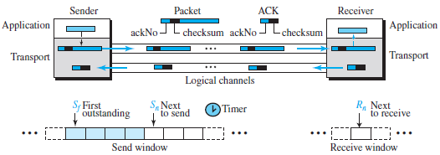
Go-Back-N protocol
Go-back-N is that we can send several packets before receiving acknowledgments, but the receiver can only buffer one packet.
We keep a copy of the sent packets until the acknowledgments arrive

Slide 40
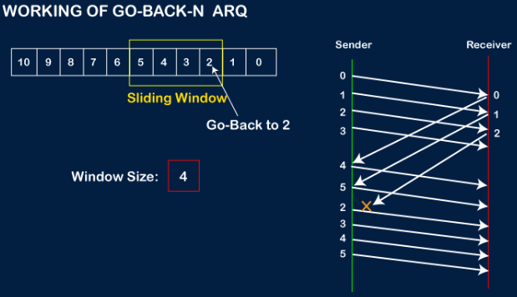

Slide 41
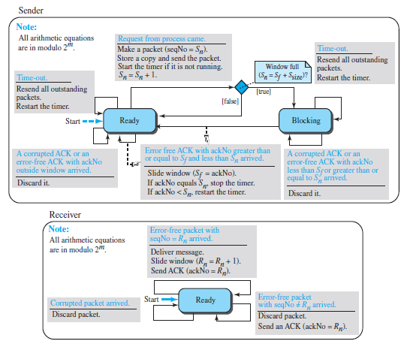
FSMs for the Go-Back-N protocol

Slide 42
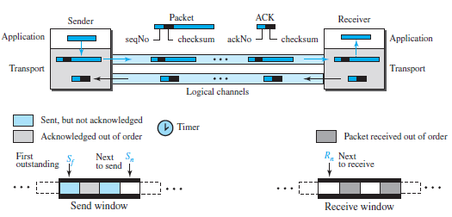
Selective Repeat Protocol

Slide 43
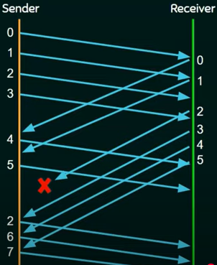

Slide 44
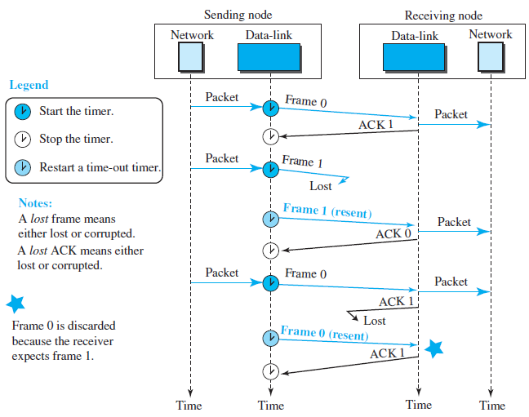
HDLC
High-level Data Link Control (HDLC) is a bit-oriented protocol for communication over point-to-point and multipoint links.

Slide 45
HDLC Transfer Modes
HDLC provides two common transfer modes that can be used in different configurations: normal response mode (NRM) and asynchronous balanced mode (ABM).
In normal response mode (NRM), the station configuration is unbalanced. We have one primary station and multiple secondary stations. A primary station can send commands; a secondary station can only respond.
In ABM, the configuration is balanced. The link is point-to-point, and each station can function as a primary and a secondary

Slide 46
HDLC Framing
HDLC defines three types of frames:
Information frames (I-frames):I-frames are used to data-link user data and control information relating to user data (piggybacking).
Supervisory frames (S-frames): S-frames are used only to transport control information
Unnumbered frames (U-frames): U-frames are reserved for system management. Information carried by U-frames is intended for managing the link itself.

Slide 47
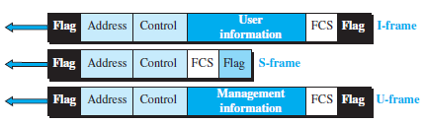
Each frame in HDLC may contain up to six fields
Flag field: This field contains synchronization pattern 01111110, which identifies both the beginning and the end of a frame.
Address field: This field contains the address of the secondary station. If a primary station created the frame, it contains a to address. If a secondary station creates the frame, it contains a from address. The address field can be one byte or several bytes long, depending on the needs of the network.

Slide 48
Control field: The control field is one or two bytes used for flow and error control. The interpretation of bits are discussed separately in the next slide.
Information field: The information field contains the user’s data from the network layer or management information. Its length can vary from one network to another.
FCS field: The frame check sequence (FCS) is the HDLC error detection field. It can contain either a 2- or 4-byte CRC.

Slide 49

Control field format for the different frame types
Control Field for I-Frames: I-frames are designed to carry user data from the network layer. In addition, they can include flow- and error-control information (piggybacking). The subfields in the control field are used to define these functions. The first bit defines the type.
If the first bit of the control field is 0, this means the frame is an I-frame.
The next 3 bits, called N(S), define the sequence number of the frame between 0 and 7.
The last 3 bits, called N(R), correspond to the acknowledgment number when piggybacking is used.
The single bit between N(S) and N(R) is called the P/F bit. The P/F field is a single bit with a dual purpose. It has meaning only when it is set (bit = 1) and can mean poll (primary station to a secondary )or final (a secondary to a primary).

Slide 50
Control Field for S-Frames
Supervisory frames are used for flow and error control whenever piggybacking is either impossible or inappropriate.
S-frames do not have information fields.
If the first 2 bits of the control field are 10, this means the frame is an S-frame. The last 3-bits called N(R), corresponds to ACK and NAK.
The 2 bits called code are used to define the type of S-frame itself.
00: Receive ready (RR)
01: Receive not ready (RNR)
10: Reject (REJ)
11: Selective reject (SREJ).

Slide 51
Control Field for U-Frames
Unnumbered frames are used to exchange session management and control information between connected devices.
Unlike S-frames, U-frames contain an information field, but one used for system management information, not user data.
U-frame codes are divided into two sections: a 2-bit prefix before the P/F bit and a 3-bit suffix after the P/F bit. Together, these two segments (5 bits) can be used to create up to 32 different types of U-frames.

Slide 52
POINT-TO-POINT PROTOCOL (PPP)
Services Provided by PPP
PPP defines the format of the frame to be exchanged between devices.
It also defines how two devices can negotiate the establishment of the link and the exchange of data.
PPP is designed to accept payloads from several network layers (not only IP).
Authentication is also provided in the protocol, but it is optional.
The new version of PPP, called Multilink PPP, provides connections over multiple links.
One interesting feature of PPP is that it provides network address configuration. This is particularly useful when a home user needs a temporary network address to connect to the Internet.

Slide 53
Services Not Provided by PPP
PPP does not provide flow control.
A sender can send several frames one after another with no concern about overwhelming the receiver.
PPP has a very simple mechanism for error control. A CRC field is used to detect errors.
If the frame is corrupted, it is silently discarded; the upper-layer protocol needs to take care of the problem.
Lack of error control and sequence numbering may cause a packet to be received out of order.
PPP does not provide a sophisticated addressing mechanism to handle frames in a multipoint configuration.

Slide 54

PPP Framing
PPP uses a character-oriented (or byte-oriented) frame.
Flag. A PPP frame starts and ends with a 1-byte flag with the bit pattern 01111110.
Address. The address field in this protocol is a constant value and set to 11111111 (broadcast address).
Control. This field is set to the constant value 00000011 (imitating unnumbered frames in HDLC). As we will discuss later, PPP does not provide any flow control. Error control is also limited to error detection.

Slide 55
Protocol: The protocol field defines what is being carried in the data field: either user data or other information. This field is by default 2 bytes long, but the two parties can agree to use only 1 byte.
Payload field: This field carries either the user data or other information that we will discuss shortly. The data field is a sequence of bytes with the default of a maximum of 1500 bytes; but this can be changed during negotiation. The data field is byte-stuffed if the flag byte pattern appears in this field. Because there is no field defining the size of the data field, padding is needed if the size is less than the maximum default value or the maximum negotiated value.
FCS: The frame check sequence (FCS) is simply a 2-byte or 4-byte standard CRC.

Slide 56
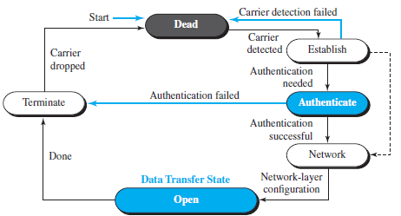
Transition Phases in PPP
PPP

Slide 57
Multiplexing of Protocols in PPP
Three sets of protocols are defined to make PPP powerful:
The Link Control Protocol (LCP): It is Responsible for establishing, maintaining, configuring, and terminating links.
Two Authentication Protocols (APs): Password Authentication Protocol (PAP) and Challenge Handshake Authentication Protocol (CHAP)
Several Network Control Protocols (NCPs): PPP is a multiple-network-layer protocol. It can carry a network-layer data packet from protocols defined by the Internet, OSI, Xerox, DECnet, AppleTalk, Novel, and so on.

